Slide 1

Chapter 2:
Data Visualization
Notes:
1

Slide 2
Objective
Understand the concept and importance of data visualization in the context of data mining.
Explore the goals and benefits of using data visualization techniques.
Learn various techniques for numerical data, including line charts, bar charts, scatter plots, etc.
Understand the techniques specific to non-numerical data, such as pie charts, word clouds, network graphs, etc.
Gain insights into the visualization of dashboards, including the components, design principles, and interactive features.
2

Slide 3
Visualization of Non-Numerical Data
Non - Numerical Data
Non-numerical data, also known as categorical data, consists of qualitative or descriptive information that cannot be measured on a numerical scale. Visualizing non-numerical data helps us understand the distribution, proportions, and relationships between different categories or groups.
3

Slide 4
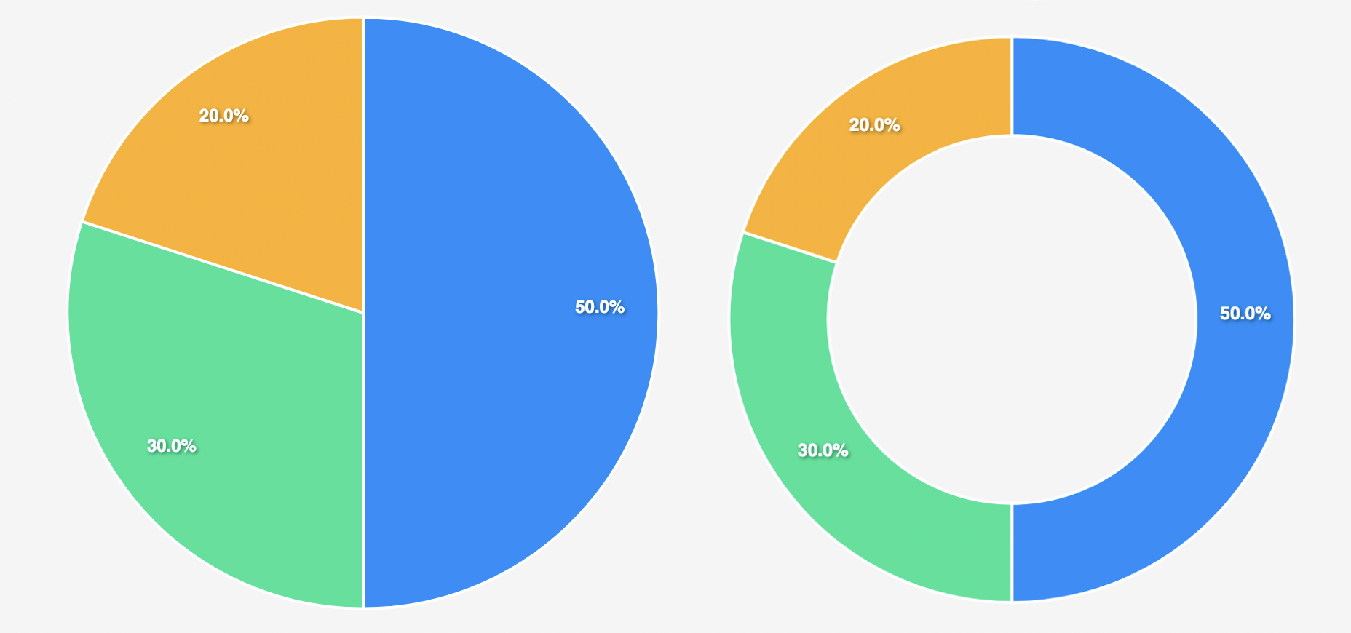
Visualization of Non-Numerical Data
Pie Charts and Donut Charts
Pie charts display the proportion of each category as slices of a circular pie. The size of each slice represents the relative frequency or proportion of the category.
Donut charts are similar to pie charts but with a hole in the center, allowing additional information or labels to be placed there.
[Credit: https://www.fusioncharts.com/ ]
4

Slide 5
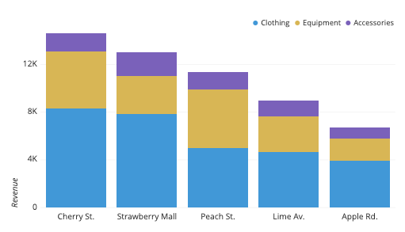
Visualization of Non-Numerical Data
Stacked Bar Charts
Stacked bar charts show the composition of a category by stacking rectangular bars on top of each other. Each bar segment represents a different subcategory, and the length of the segment represents its proportion.
[Credit: https://www.fusioncharts.com/ ]
5

Slide 6

Visualization of Non-Numerical Data
Word Clouds and Tag Clouds
Word clouds visually represent textual data, such as keywords or word frequencies, by displaying the words in different sizes based on their frequency or importance.
Tag clouds are similar to word clouds but display tags or labels in varying font sizes to represent their frequency or significance.
[Credit: https://www.fusioncharts.com/ ]
6

Slide 7
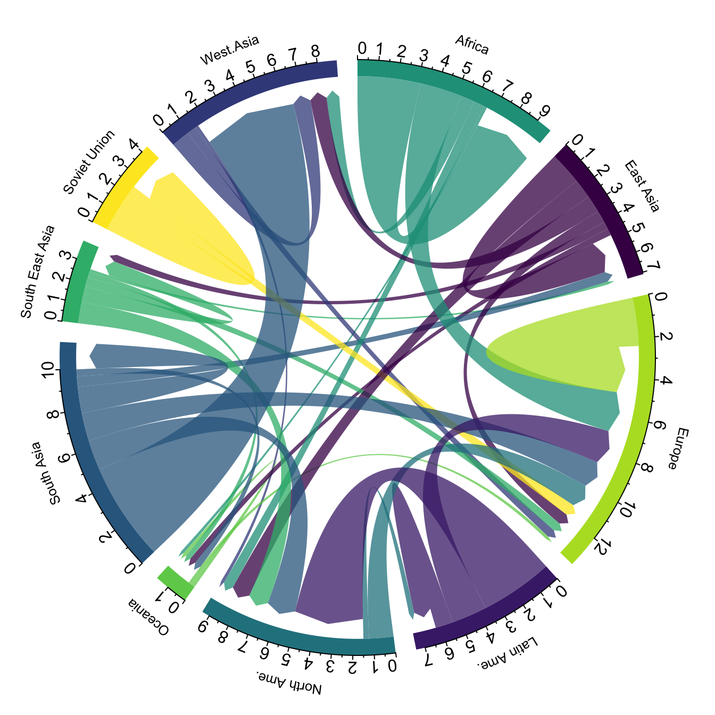
Visualization of Non-Numerical Data
Chord Diagrams and Network Graphs
Chord diagrams display the relationships and flows between different entities or categories. They use arcs or ribbons to connect the entities, with the width of the arcs representing the strength or frequency of the connections.
Network graphs (or node-link diagrams) represent relationships between entities as nodes (vertices) connected by edges (lines). They are effective for visualizing complex networks or social relationships.
[Credit: https://www.fusioncharts.com/ ]
7

Slide 8
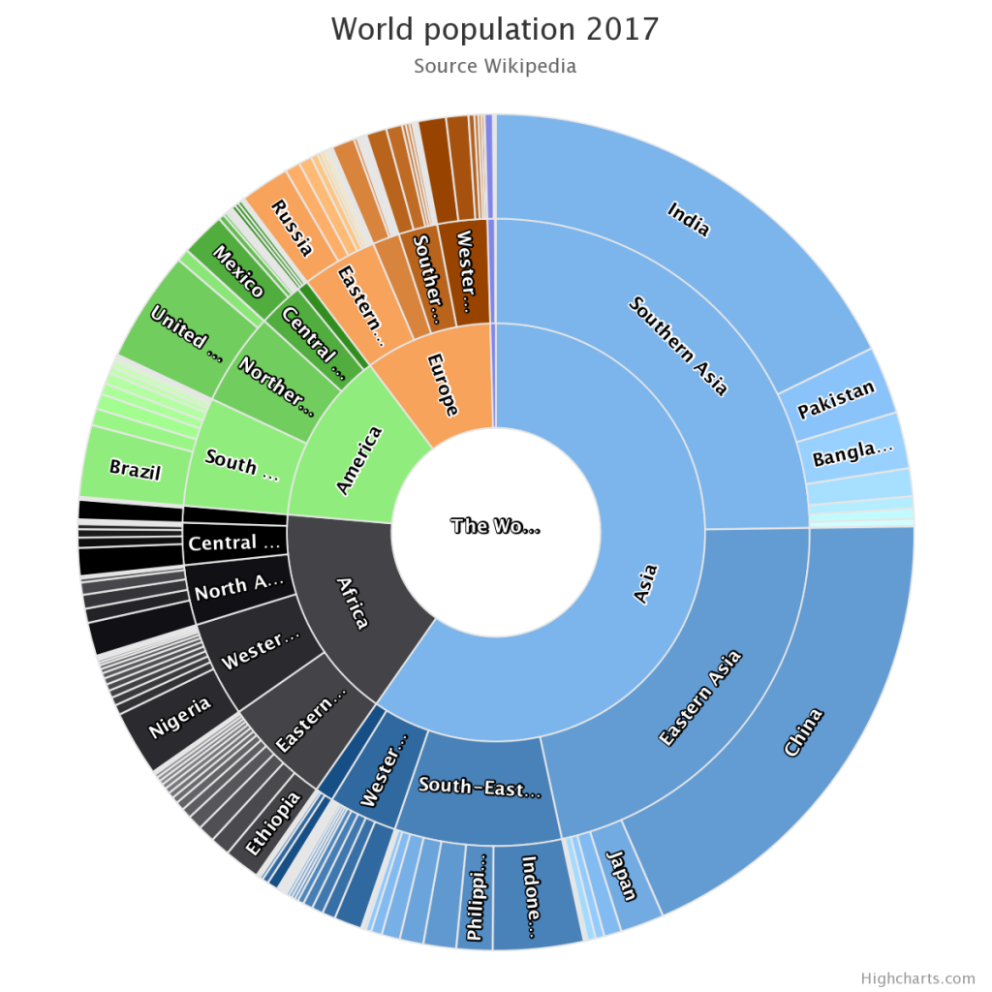
Visualization of Non-Numerical Data
Tree Diagrams and Sunburst Charts
Tree diagrams represent hierarchical structures or relationships by using a branching structure with nodes. Each level represents a different category, and the size or color of the nodes can represent additional information.
Sunburst charts are an extension of tree diagrams where the hierarchy is displayed as concentric circles. The size or angle of each sector represents the proportion or value associated with the category.
[Credit: https://www.fusioncharts.com/ ]
8

Slide 9
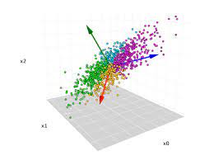
Visualization of Non-Numerical Data
Methods for Visualizing High-Dimensional Data: Principal Component Analysis
Dimensionality reduction technique used to transform high-dimensional data into a lower-dimensional space while retaining most of the original data variability.
Steps of PCA:
  Standardize the data
  Compute the covariance matrix
  Calculate the eigenvectors and eigenvalues
  Choose the principal components
  Project the data
[Credit: https://www.fusioncharts.com/ ]
9

Slide 10
Visualization of Non-Numerical Data
Methods for Visualizing High-Dimensional Data: Multidimensional Scaling
Technique used to visualize similarities and dissimilarities between data points in a lower-dimensional space.
Steps of MDS:
  Define the distance matrix: Computing the pairwise distances or dissimilarities between data points.
  Apply dimensionality reduction: Finding a lower-dimensional representation that preserves the pairwise distances as closely as possible.
  Metric vs. Non-metric MDS: Metric MDS preserves the actual distances, while non-metric MDS preserves the rank order of distances.
10

Slide 11
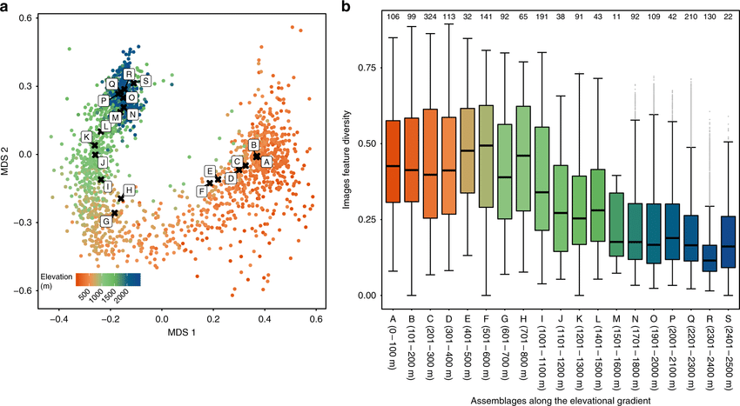
Visualization of Non-Numerical Data
Methods for Visualizing High-Dimensional Data: Multidimensional Scaling
[Credit: https://www.fusioncharts.com/ ]
11

Slide 12
Visualization of Non-Numerical Data
Parallel Coordinates Plot for High-Dimensional Data
Visualization technique that displays multivariate data on parallel axes, where each axis represents a different variable.
Plot Construction:
  Each data point is represented by a line connecting the points on each parallel axis corresponding to its variable values.
  Data points with similar patterns will have lines that are closer together, and outliers will stand out.
12

Slide 13
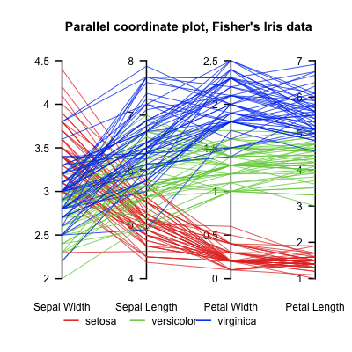
Visualization of Non-Numerical Data
Parallel Coordinates Plot for High-Dimensional Data
[Credit: https://www.fusioncharts.com/ ]
13

Slide 14
Visualization of Non-Numerical Data
Comparison of Methods
PCA vs. MDS
  PCA focuses on capturing variance and pattern preservation, while MDS emphasizes on distance preservation.
  PCA is ideal for data compression and feature selection, whereas MDS is suitable for visualizing similarity and dissimilarity structures.
PCA vs. Parallel Coordinates Plot
  PCA projects data points onto new dimensions, making it suitable for dimensionality reduction and visualization.
  Parallel coordinates plot displays data points directly on the original variables, enabling a detailed view of individual data records.
14

Slide 15
Visualization of Non-Numerical Data
Comparison of Methods
MDS vs. Parallel Coordinates Plot
  MDS aims to visualize pairwise distances, which is valuable for understanding the dissimilarity structure in data.
  Parallel coordinates plot is more focused on exploring relationships between variables, highlighting patterns ansd trends.
Choosing the Right Method:
  Selection Criteria:
    Data characteristics
    Analysis goals
    Data exploration
  Iterative Process and Experimentation
15

Slide 16
Visualization of Non-Numerical Data
Considerations for Visualizing Non-Numerical Data Effectively
Choose the appropriate visualization technique based on the nature of the non-numerical data and the insights you want to convey.
Use clear and concise labels for each category or entity to ensure understanding and interpretation.
Apply appropriate colors and visual cues to distinguish different categories or groups.
Ensure the visualization accurately represents the proportions or relationships between the non-numerical data.
Use interactivity, such as tooltips or filtering, to provide additional information or allow users to explore the data in more detail.
16

Slide 17
Summary
Visualization of Non - Numerical Data
Techniques for Non-Numerical Data:
- Explore techniques tailored for non-numerical data.
- Examples include pie charts, word clouds, network graphs, etc.
17

